Slide 1
Memory
Memory Hierarchy: Caches

Slide 2
Introduction
An ideal computing system has unlimited fast memory
Obviously, this is not possible
A memory hierarchy gives the illusion of large amounts of fast memory

Slide 3
Principle of Locality
Programs access only a small proportion of their address space at any time
Temporal locality
Items accessed recently are likely to be accessed again soon
e.g., instructions in a loop, induction variables
Spatial locality
Items near those accessed recently are likely to be accessed soon
E.g., sequential instruction access, array data

Slide 4
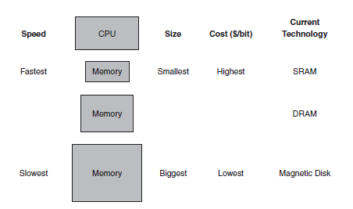
Memory Hierarchy
Smaller, faster memory is closer to the processor

Slide 5
Caches
Permanent storage on disk
Copy recently accessed and nearby items from disk to smaller DRAM memory
Main memory
Copy recently accessed and nearby items from DRAM to smaller SRAM memory
Cache memory attached to CPU
Cache may also refer to any storage that takes advantage of locality

Slide 6
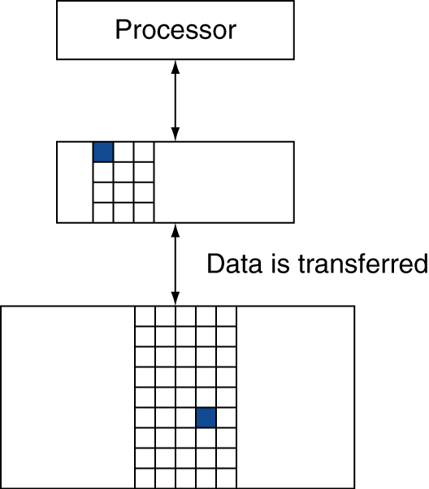
Memory Hierarchy Levels
Block: unit of copying
May be multiple words
If accessed data is present in upper level
Hit: access satisfied by upper level
Hit ratio: hits/accesses
If accessed data is absent
Miss: block copied from lower level
Time taken: miss penalty
Miss ratio: misses/accesses = 1 – hit ratio
Then accessed data supplied from upper level

Slide 7
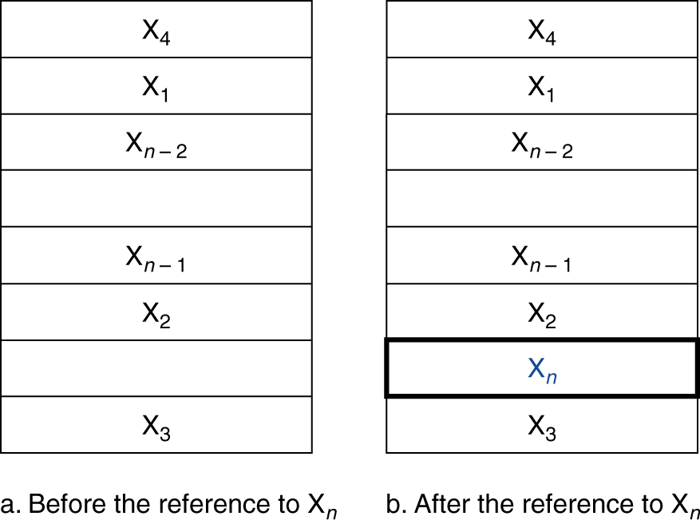
Cache Memory
Cache memory
The level of the memory hierarchy closest to the CPU
Given accesses X₁, …, X_{n–1}, X_{n}
How do we know if the data is present?
Where do we look?

Slide 8
Direct Mapped Cache
Each word can go in exactly one place in the cache
Assign a location based on the address of the word
(Block address) modulo (#Blocks in cache)

Slide 9
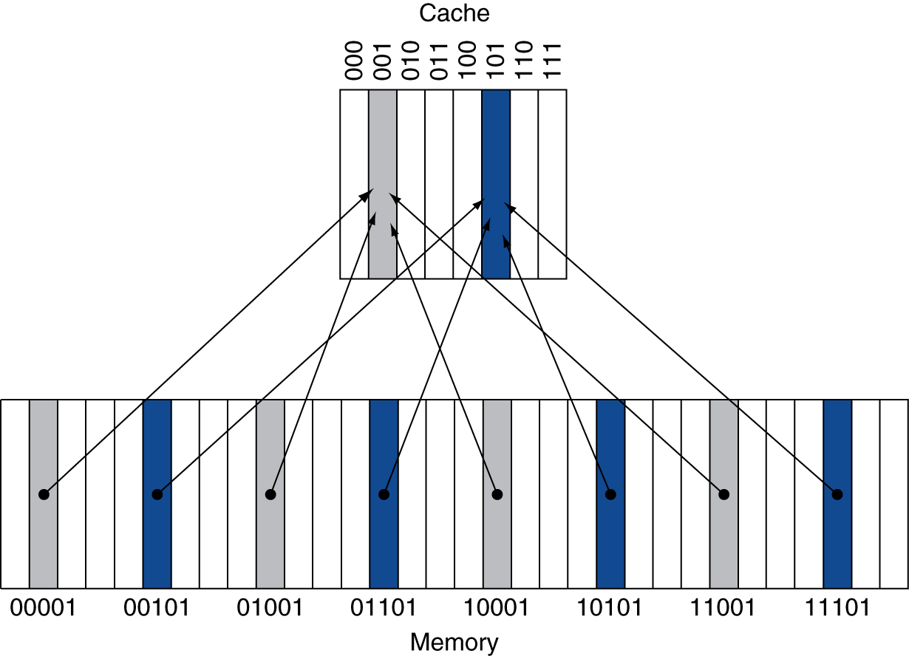
Direct Mapped Cache
Each word can go in exactly one place in the cache
Assign a location based on the address of the word
(Block address) modulo (#Blocks in cache)

Slide 10
Direct Mapped Cache
Each word can go in exactly one place in the cache
Assign a location based on the address of the word
(Block address) modulo (#Blocks in cache)
#Blocks is a power of 2
Use low-order address bits

Slide 11
Tags and Valid Bits
How do we know which particular block is stored in a cache location?
Store block address as well as the data
Only need the high-order bits
Called the tag
What if there is no data in a location?
Valid bit: 1 = present, 0 = not present
Initially 0

Slide 12
Cache Read
Reads are simpler because reads do not change the contents of the cache
Example:
8-Block, Direct Mapped Cache
Addresses:
Binary Decimal Cache Block (address mod 8)
10110 22 110
11010 26 010
10110 22 110
11010 26 010
10000 16 000
00011 3 011
10000 16 000
10010 18 010
10000 16 000

Slide 13
Cache Example
Initial state
Index | V | Tag | Data
000 | N
001 | N
010 | N
011 | N
100 | N
101 | N
110 | N
111 | N

Slide 14
Cache Example
Word addr | Binary addr | Hit/miss | Cache block
22 | 10 110 | Miss | 110
Index | V | Tag | Data
000 | N
001 | N
010 | N
011 | N
100 | N
101 | N
110 | Y | 10 | Mem[10110]
111 | N

Slide 15
Cache Example
Word addr | Binary addr | Hit/miss | Cache block
26 | 11 010 | Miss | 010
Index | V | Tag | Data
000 | N
001 | N
010 | Y | 11 | Mem[11010]
011 | N
100 | N
101 | N
110 | Y | 10 | Mem[10110]
111 | N

Slide 16
Cache Example
Word addr | Binary addr | Hit/miss | Cache block
22 | 10 110 | Hit | 110
26 | 11 010 | Hit | 010
Index | V | Tag | Data
000 | N
001 | N
010 | Y | 11 | Mem[11010]
011 | N
100 | N
101 | N
110 | Y | 10 | Mem[10110]
111 | N

Slide 17
Cache Example
Word addr | Binary addr | Hit/miss | Cache block
16 | 10 000 | Miss | 000
3 | 00 011 | Miss | 011
16 | 10 000 | Hit | 000
Index | V | Tag | Data
000 | Y | 10 | Mem[10000]
001 | N
010 | Y | 11 | Mem[11010]
011 | Y | 00 | Mem[00011]
100 | N
101 | N
110 | Y | 10 | Mem[10110]
111 | N

Slide 18
Cache Example
Word addr | Binary addr | Hit/miss | Cache block
18 | 10 010 | Miss | 010
Index | V | Tag | Data
000 | Y | 10 | Mem[10000]
001 | N
010 | Y | 10 | Mem[10010]
011 | Y | 00 | Mem[00011]
100 | N
101 | N
110 | Y | 10 | Mem[10110]
111 | N

Slide 19
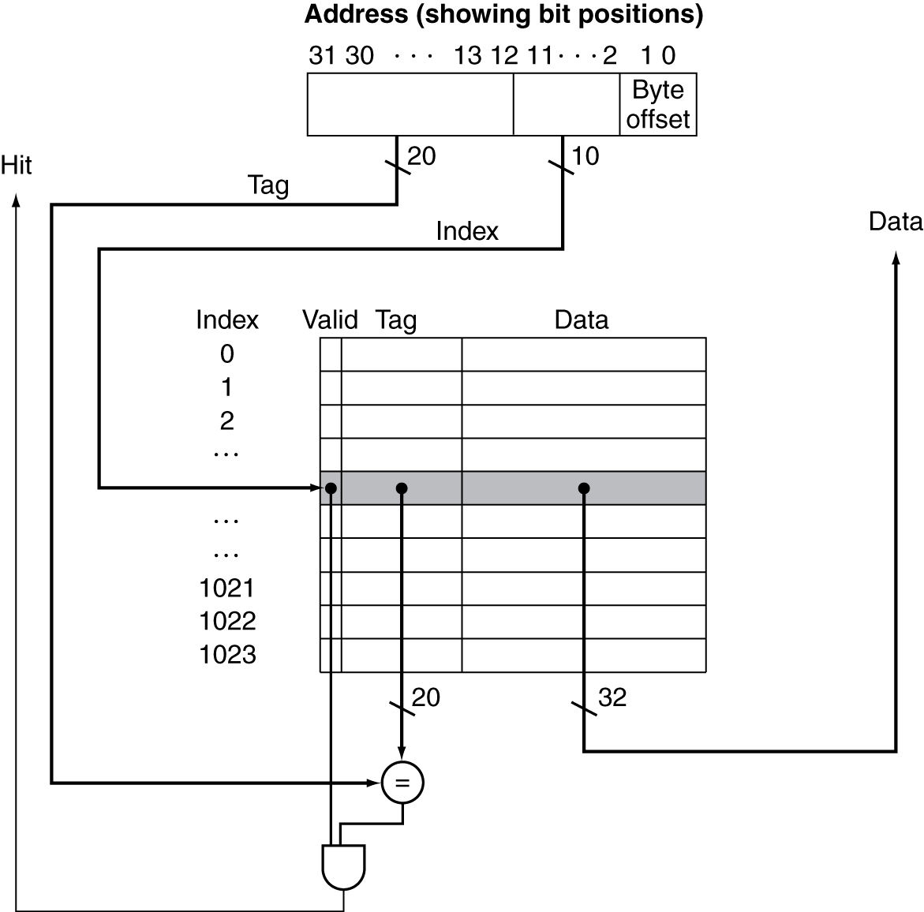
Address Subdivision

Slide 20
Cache Hit
Index of the address specifies cache block
If the valid bit indicates data is present, check the tags
If the tags match, it is a hit
We can use the data stored in the cache
CPU proceeds normally

Slide 21
Cache Misses
If the valid bit is not set or if the tags do not match, it is a miss
Control unit must detect and process a miss
Creates a stall in the pipeline

Slide 22
Cache Miss (Instruction Memory)
Send the original PC value (current PC – 4) to the memory.
Instruct main memory to perform a read and wait for the memory to complete its access.
Write the cache entry, putting the data from memory in the data portion of the entry, writing the upper bits of the address (from the ALU) into the tag field, and turning the valid bit on.
Restart the instruction execution at the first step, which will refetch the instruction, this time finding it in the cache.

Slide 23
Cache Miss
Stall until the data is fetched from memory
Instruction cache miss
Restart instruction fetch
Data cache miss
Complete data access

Slide 24
Cache Miss
Misses are classified into three different types
Compulsory (cold start)
First access to a piece of data
Cannot be avoided
Capacity
Working set of program is larger than cache size
Not enough room to cache a locality
Conflict
collisions, multiple blocks competing for the same space
Misses may be reduced by changing the associativity of the cache

Slide 25
Cache Organizations
Direct mapped
Set associative
Fully associative

Slide 26
Fully Associative
A block in memory may be associated with any entry in the cache
Requires all entries to be searched at once
Comparator per entry (expensive)

Slide 27
N-way Set Associative
Each block may go to n locations
Each set contains n entries
Block number determines which set
(Block number) modulo (#Sets in cache)
Search all entries in a given set at once
n comparators (less expensive)

Slide 28
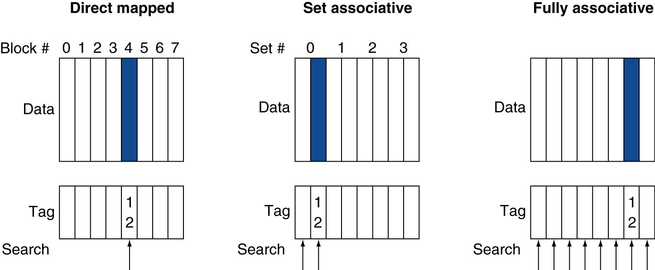
Associative Cache Example

Slide 29
Associativity
All cache organizations are a variation of set associativity.
Direct mapped: 1-way set associative
Fully associative: m-way associative where m is the number of blocks in the cache

Slide 30
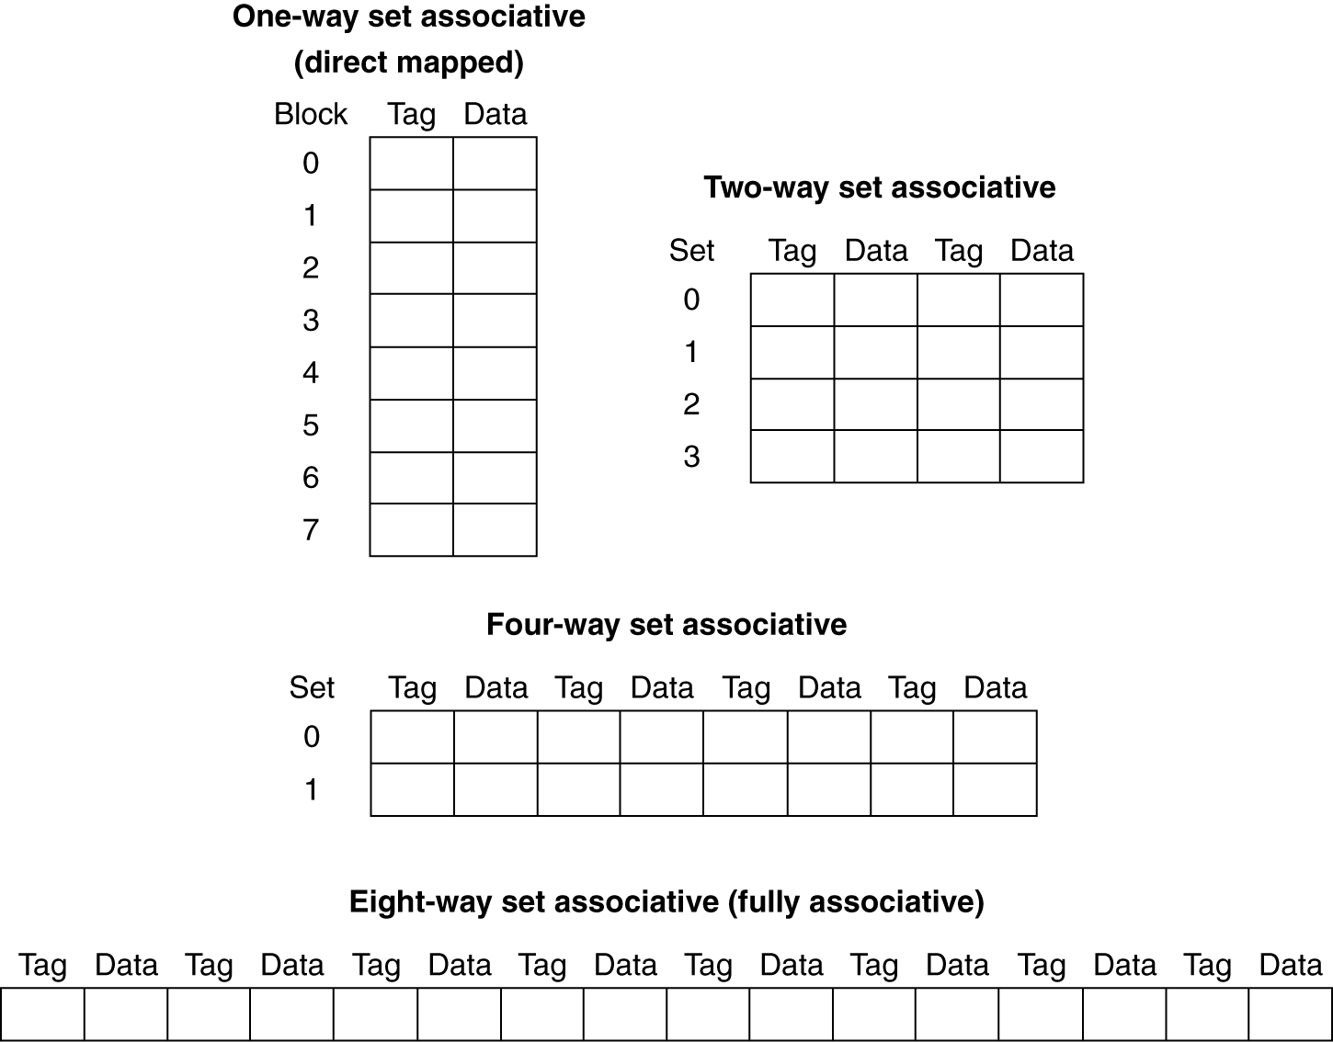
Spectrum of Associativity
For a cache with 8 entries

Slide 31
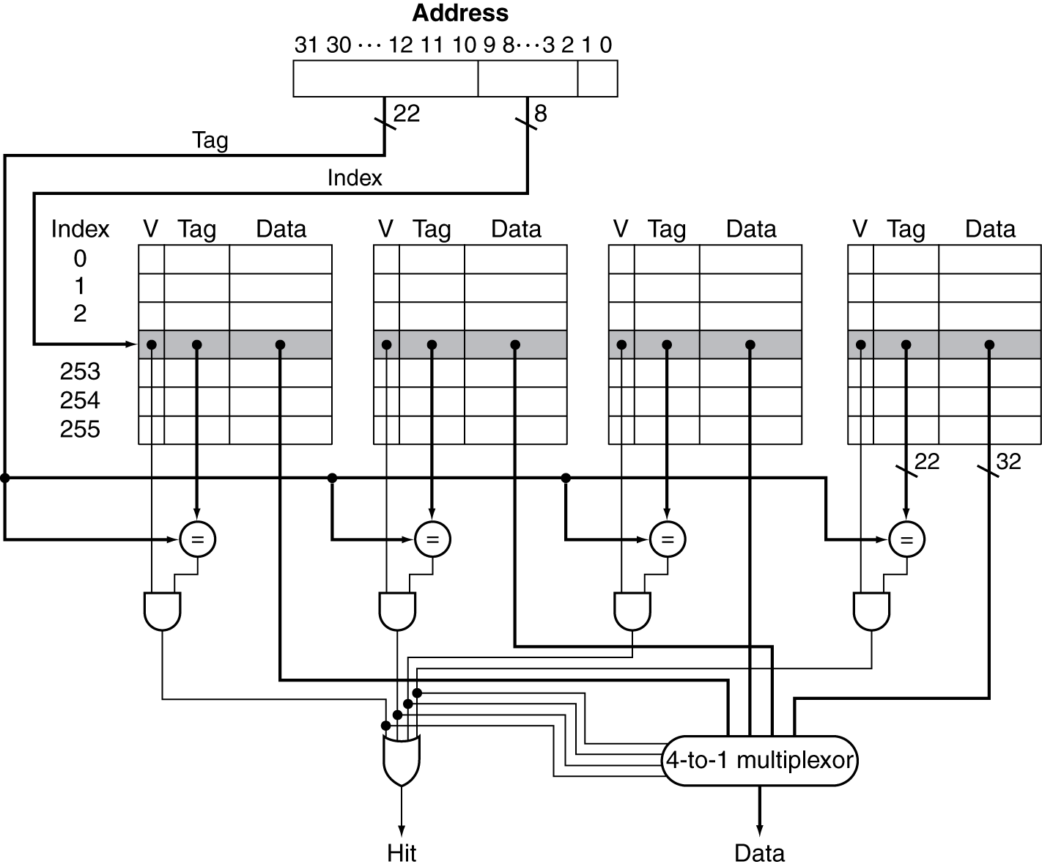
Set Associative Cache Organization

Slide 32
Replacement Policy
Direct mapped: no choice
Set associative
Prefer non-valid entry, if there is one
Otherwise, choose among entries in the set
Least-recently used (LRU)
Choose the one unused for the longest time
Simple for 2-way, manageable for 4-way, too hard beyond that
Random
Gives approximately the same performance as LRU for high associativity

Slide 33
Associativity Example
Compare 4-block caches
Direct mapped, 2-way set associative, fully associative
Block access sequence: 0, 8, 0, 6, 8
Direct mapped
Block address | Cache index | Hit/miss | Cache content after access
 |  |  | 0 | 1 | 2 | 3

Slide 34
Associativity Example
Compare 4-block caches
Direct mapped, 2-way set associative, fully associative
Block access sequence: 0, 8, 0, 6, 8
Direct mapped
Block address | Cache index | Hit/miss | Cache content after access
 |  |  | 0 | 1 | 2 | 3
0 | 0 | miss | Mem[0]

Slide 35
Associativity Example
Compare 4-block caches
Direct mapped, 2-way set associative, fully associative
Block access sequence: 0, 8, 0, 6, 8
Direct mapped
Block address | Cache index | Hit/miss | Cache content after access
 |  |  | 0 | 1 | 2 | 3
0 | 0 | miss | Mem[0]
8 | 0 | miss | Mem[8]

Slide 36
Associativity Example
Compare 4-block caches
Direct mapped, 2-way set associative, fully associative
Block access sequence: 0, 8, 0, 6, 8
Direct mapped
Block address | Cache index | Hit/miss | Cache content after access
 |  |  | 0 | 1 | 2 | 3
0 | 0 | miss | Mem[0]
8 | 0 | miss | Mem[8]
0 | 0 | miss | Mem[0]

Slide 37
Associativity Example
Compare 4-block caches
Direct mapped, 2-way set associative, fully associative
Block access sequence: 0, 8, 0, 6, 8
Direct mapped
Block address | Cache index | Hit/miss | Cache content after access
 |  |  | 0 | 1 | 2 | 3
0 | 0 | miss | Mem[0]
8 | 0 | miss | Mem[8]
0 | 0 | miss | Mem[0]
6 | 2 | miss | Mem[0] |  | Mem[6]

Slide 38
Associativity Example
Compare 4-block caches
Direct mapped, 2-way set associative, fully associative
Block access sequence: 0, 8, 0, 6, 8
Direct mapped
Block address | Cache index | Hit/miss | Cache content after access
 |  |  | 0 | 1 | 2 | 3
0 | 0 | miss | Mem[0]
8 | 0 | miss | Mem[8]
0 | 0 | miss | Mem[0]
6 | 2 | miss | Mem[0] |  | Mem[6]
8 | 0 | miss | Mem[8] |  | Mem[6]

Slide 39
Associativity Example
Compare 4-block caches
Direct mapped, 2-way set associative, fully associative
Block access sequence: 0, 8, 0, 6, 8
Direct mapped
5 misses
Block address | Cache index | Hit/miss | Cache content after access
 |  |  | 0 | 1 | 2 | 3
0 | 0 | miss | Mem[0]
8 | 0 | miss | Mem[8]
0 | 0 | miss | Mem[0]
6 | 2 | miss | Mem[0] |  | Mem[6]
8 | 0 | miss | Mem[8] |  | Mem[6]

Slide 40
Associativity Example
Compare 4-block caches
Direct mapped, 2-way set associative, fully associative
Block access sequence: 0, 8, 0, 6, 8
2-way set associative
Block address | Cache index | Hit/miss | Cache content after access
 |  |  | Set 0 |  | Set 1

Slide 41
Associativity Example
Compare 4-block caches
Direct mapped, 2-way set associative, fully associative
Block access sequence: 0, 8, 0, 6, 8
2-way set associative
Block address | Cache index | Hit/miss | Cache content after access
 |  |  | Set 0 |  | Set 1
0 | 0 | miss | Mem[0]

Slide 42
Associativity Example
Compare 4-block caches
Direct mapped, 2-way set associative, fully associative
Block access sequence: 0, 8, 0, 6, 8
2-way set associative
Block address | Cache index | Hit/miss | Cache content after access
 |  |  | Set 0 |  | Set 1
0 | 0 | miss | Mem[0]
8 | 0 | miss | Mem[0] | Mem[8]

Slide 43
Associativity Example
Compare 4-block caches
Direct mapped, 2-way set associative, fully associative
Block access sequence: 0, 8, 0, 6, 8
2-way set associative
Block address | Cache index | Hit/miss | Cache content after access
 |  |  | Set 0 |  | Set 1
0 | 0 | miss | Mem[0]
8 | 0 | miss | Mem[0] | Mem[8]
0 | 0 | hit | Mem[0] | Mem[8]

Slide 44
Associativity Example
Compare 4-block caches
Direct mapped, 2-way set associative, fully associative
Block access sequence: 0, 8, 0, 6, 8
2-way set associative
Block address | Cache index | Hit/miss | Cache content after access
 |  |  | Set 0 |  | Set 1
0 | 0 | miss | Mem[0]
8 | 0 | miss | Mem[0] | Mem[8]
0 | 0 | hit | Mem[0] | Mem[8]
6 | 0 | miss | Mem[0] | Mem[6]

Slide 45
Associativity Example
Compare 4-block caches
Direct mapped, 2-way set associative, fully associative
Block access sequence: 0, 8, 0, 6, 8
2-way set associative
Block address | Cache index | Hit/miss | Cache content after access
 |  |  | Set 0 |  | Set 1
0 | 0 | miss | Mem[0]
8 | 0 | miss | Mem[0] | Mem[8]
0 | 0 | hit | Mem[0] | Mem[8]
6 | 0 | miss | Mem[0] | Mem[6]
8 | 0 | miss | Mem[8] | Mem[6]

Slide 46
Associativity Example
Compare 4-block caches
Direct mapped, 2-way set associative, fully associative
Block access sequence: 0, 8, 0, 6, 8
2-way set associative
4 misses
Block address | Cache index | Hit/miss | Cache content after access
 |  |  | Set 0 |  | Set 1
0 | 0 | miss | Mem[0]
8 | 0 | miss | Mem[0] | Mem[8]
0 | 0 | hit | Mem[0] | Mem[8]
6 | 0 | miss | Mem[0] | Mem[6]
8 | 0 | miss | Mem[8] | Mem[6]

Slide 47
Associativity Example
Compare 4-block caches
Direct mapped, 2-way set associative, fully associative
Block access sequence: 0, 8, 0, 6, 8
Fully associative
3 misses
Block address |  | Hit/miss | Cache content after access
0 |  | miss | Mem[0]
8 |  | miss | Mem[0] | Mem[8]
0 |  | hit | Mem[0] | Mem[8]
6 |  | miss | Mem[0] | Mem[8] | Mem[6]
8 |  | hit | Mem[0] | Mem[8] | Mem[6]

Slide 48
How Much Associativity
Increased associativity decreases miss rate
But with diminishing returns
Simulation of a system with 64KB cache, 16-word blocks
1-way: 10.3%
2-way: 8.6%
4-way: 8.3%
8-way: 8.1%

Slide 49
Cache Write
If we replace the data memory in our datapath with a cache, what happens on a store word instruction?
If we wrote the data into only the data cache without changing main memory; then main memory would have a different value from that in the cache.
In such a case, the cache and memory are said to be inconsistent.

Slide 50
Write-Through
Whenever changes are made to the data in the cache, also change the data in main memory.

Slide 51
Write-Through
Whenever changes are made to the data in the cache, also change the data in main memory.
Writes take longer
Suppose 10% of instructions are stores and write to memory takes 100 cycles
If base CPI = 1, then effective CPI = 1 + 0.1×100 = 11

Slide 52
Write-Through
Whenever changes are made to the data in the cache, also change the data in main memory.
Writes take longer
Solution: write buffer
Holds data waiting to be written to memory
CPU continues immediately
Only stalls on write if write buffer is already full

Slide 53
Write-Back
On data-write hit, just update the block in cache
Keep track of whether each block is “clean” or “dirty”
When a dirty block is replaced
Write it back to memory
Can use a write buffer to allow replacing block to be read first

Slide 54
Write Allocation
What should happen on a write miss?
Alternatives for write-through
Allocate on miss: fetch the block
Write around: don’t fetch the block
Since programs often write a whole block before reading it (e.g., initialization)
For write-back
Usually fetch the block

Slide 55
Performance
The time to service hits and misses affects the CPU time.
Hit time
time required to access the cache
includes time to determine if it’s a hit or a miss
Miss penalty
time required to fetch a block from the next lowest level
Hit time < Miss penalty

Slide 56
Measuring Cache Performance
Components of CPU time
Program execution cycles
Includes cache hit time
Memory stall cycles
Mainly from cache misses
CPU time = (CPU cycles + Memory-stall cycles) * Clock cycle time
Memory-stall cycles = Read-stall cycles + Write-stall cycles
Read-stall cycles = Reads/Program * Read miss rate * Read miss penalty
Write-stall cycles = (Writes/Program * write miss rate * write miss penalty) + Write buffer stalls

Slide 57
Measuring Cache Performance
Components of CPU time
Program execution cycles
Includes cache hit time
Memory stall cycles
Mainly from cache misses

Slide 58
Cache Performance Example
Assume an instruction cache miss rate for a program is 2% and a data cache miss rate is 4%. If a processor has a CPI of 2 without any memory stalls and the miss penalty is 100 cycles for all misses, determine how much faster a processor would run with a perfect cache that never missed. Assume the frequency of all loads and stores is 36%.

Slide 59
Cache Performance Example
Given
I-cache miss rate = 2%
D-cache miss rate = 4%
Base CPI (ideal cache) = 2
Miss penalty = 100 cycles
Load & stores are 36% of instructions

Slide 60
Cache Performance Example
Given
I-cache miss rate = 2%
D-cache miss rate = 4%
Base CPI (ideal cache) = 2
Miss penalty = 100 cycles
Load & stores are 36% of instructions
Determine miss cycles per instruction
I-cache: 0.02 × 100 = 2
D-cache: 0.36 × 0.04 × 100 = 1.44
Memory miss cycles = 2 + 1.44 = 3.44

Slide 61
Cache Performance Example
Given
I-cache miss rate = 2%
D-cache miss rate = 4%
Base CPI (ideal cache) = 2
Miss penalty = 100 cycles
Load & stores are 36% of instructions
Determine miss cycles per instruction
I-cache: 0.02 × 100 = 2
D-cache: 0.36 × 0.04 × 100 = 1.44
Memory miss cycles = 2 + 1.44 = 3.44
Actual CPI = 2 + 3.44 = 5.44

Slide 62
Cache Performance Example
Given
I-cache miss rate = 2%
D-cache miss rate = 4%
Base CPI (ideal cache) = 2
Miss penalty = 100 cycles
Load & stores are 36% of instructions
Determine miss cycles per instruction
I-cache: 0.02 × 100 = 2
D-cache: 0.36 × 0.04 × 100 = 1.44
Memory miss cycles = 2 + 1.44 = 3.44
Actual CPI = 2 + 3.44 = 5.44
Ideal CPU is 5.44/2 =2.72 times faster

Slide 63
Performance Considerations
What happens if the processor is made faster, but the memory system is not?
The amount of time spent on memory stalls will take up an increasing fraction of the execution time
Amdahl’s law

Slide 64
Cache Performance Example Revisit
Suppose we speed up the system by reducing its CPI from 2 to 1 without changing the clock rate.
Actual CPI = 1 + 3.44 = 4.44
Ideal CPU is 4.44/1 = 4.44 times faster
Amount of time spent on memory stalls increases:
Before: 3.44/5.44 = 63%
Now: 3.44/4.44 = 77%

Slide 65
Performance Considerations
Increasing clock rate without changing the memory system also increases the performance lost due to cache misses.
Memory stalls account for more CPU cycles

Slide 66
Performance Considerations
Hit Access Time
If the hit time increases, the total time to access a word from the memory system will increase.
Affect by:
Cache size
Number of pipeline stages
Cache organization

Slide 67
Multilevel Caches
Primary cache attached to CPU
Small, but fast
Level-2 cache services misses from primary cache
Larger, slower, but still faster than main memory
Main memory services L-2 cache misses
Some high-end systems include L-3 cache

Slide 68
Multilevel Cache Example
Suppose we have a processor with a base CPI of 1.0, assuming all references hit in the primary cache, and a clock rate of 5 GHz. Assume a main memory access time of 100 ns, including all the miss handling. Suppose the miss rate per instruction at the primary cache is 2%.
How much faster will the processor be if we add a secondary cache that has a 5 ns access time for either a hit or a miss and is large enough to reduce the miss rate to main memory to 0.5%?

Slide 69
Multilevel Cache Example
Given
CPU base CPI = 1
CPU clock rate = 5 GHz
Miss rate/instruction = 2%
Main memory access time = 100ns

Slide 70
Multilevel Cache Example
Given
CPU base CPI = 1
CPU clock rate = 5 GHz
Miss rate/instruction = 2%
Main memory access time = 100ns
With just primary cache
Miss penalty = 100ns/0.2ns = 500 cycles
Effective CPI = 1 + 0.02 × 500 = 11

Slide 71
Multilevel Cache Example
Now add L-2 cache
Access time = 5ns
Global miss rate to main memory = 0.5%
Primary miss with L-2 hit
Penalty = 5ns/0.2ns = 25 cycles
Primary miss with L-2 miss
Extra penalty = 500 cycles
CPI = 1 + 0.02 × 25 + 0.005 × 500 =4
Performance ratio = 11/4 = 2.8

Slide 72
Multilevel Cache Considerations
Primary cache
Focus on minimal hit time
L-2 cache
Focus on low miss rate to avoid main memory access
Hit time has less overall impact
Results
L-1 cache usually smaller than a single cache
L-1 block size smaller than L-2 block size

Slide 73
Summary
Cost/Performance tradeoff in memory technologies
Create an illusion of large amounts of fast memory with a hierarchy
Uses caches close to the processor
Cache Details
Organization: direct mapped, set associative, fully associative
Write policy: write-through vs. write-back
Replacement policy: direct, LRU, random

Slide 74
Summary
Tradeoffs to Improve Cache Performance:
Use better technology
Use faster RAMs
Cost and availability are limitations
Decrease Hit Time
Make cache smaller, but miss rate increases
Use direct mapped, but miss rate increases
Decrease Miss Rate
Make cache larger, but can increases hit time
Add associativity, but can increase hit time
Increase block size, but increases miss penalty
Decrease Miss Penalty
Reduce transfer time component of miss penalty
Add another level of cache

